Slide 1

TN CyberTech Bank Website Report

Slide 2
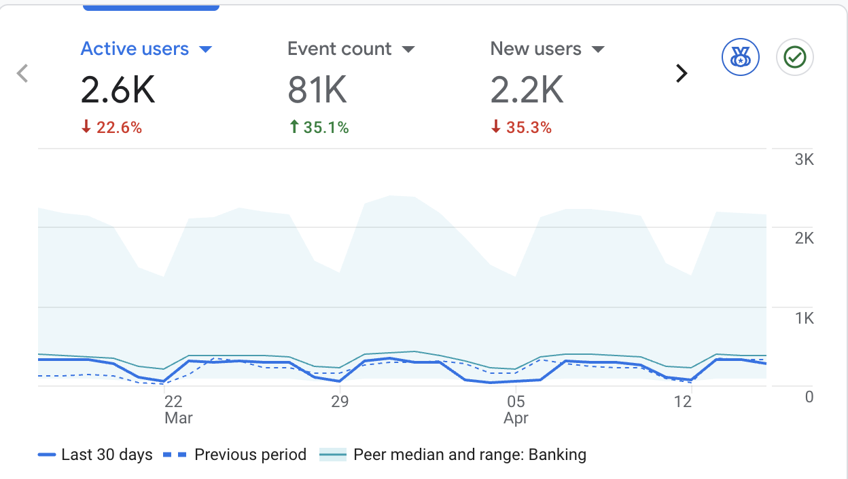
Site Overview
The large line chart on the right displays the key metrics for the TN CyberTech Bank website in the last 30 days.
It shows:
Total Users : 2.6K users visited the site.
Returning Users : 2K users who visited the site for the first time.
Average Engagement Time : Users spent an average of 1m 39s seconds on the site.

Slide 3
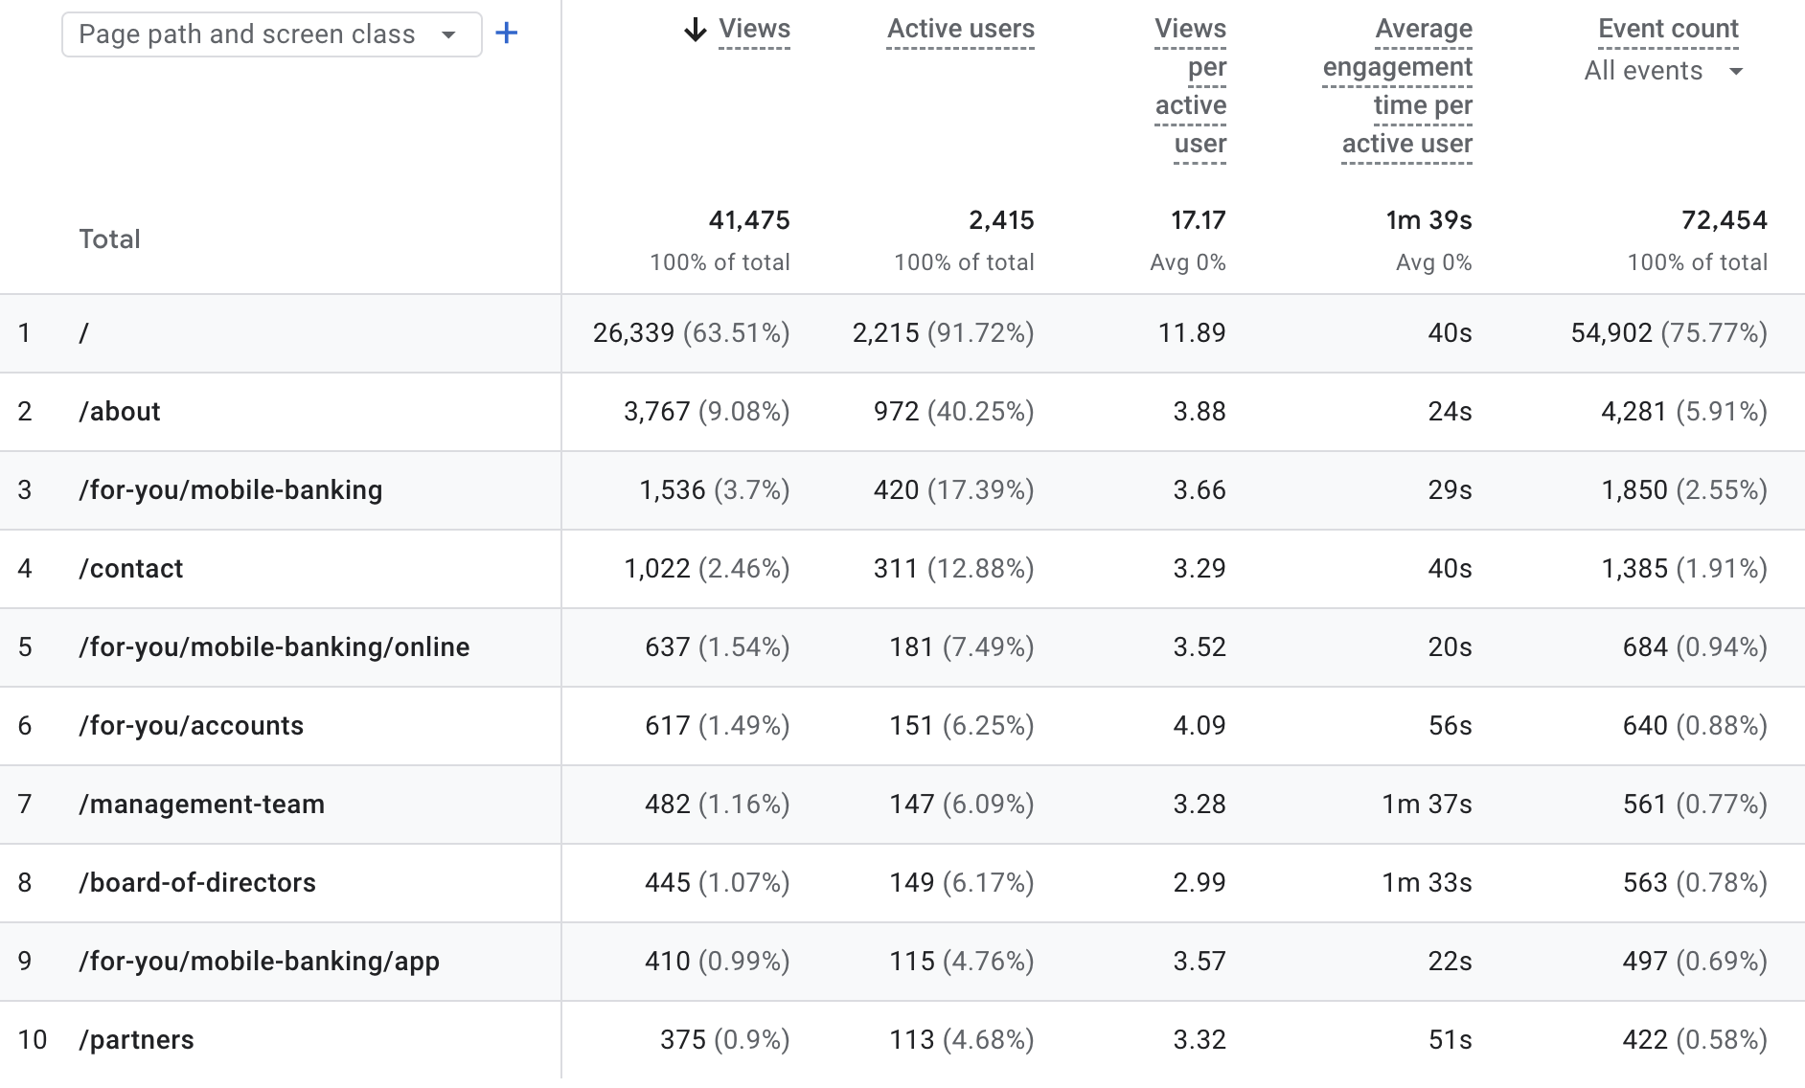
Pages Sessions
The homepage ("/") dominates traffic, bringing in 63.5% of total views and over 90% of users, making it the main entry point.
The /about page is the second most visited, but traffic drops significantly after the homepage.
Mobile banking-related pages collectively get moderate interest, but each individual page has relatively low engagement.
Pages like /management-team and /board-of-directors have longer engagement times (1m30s+), meaning users who visit them are more interested.

Slide 4
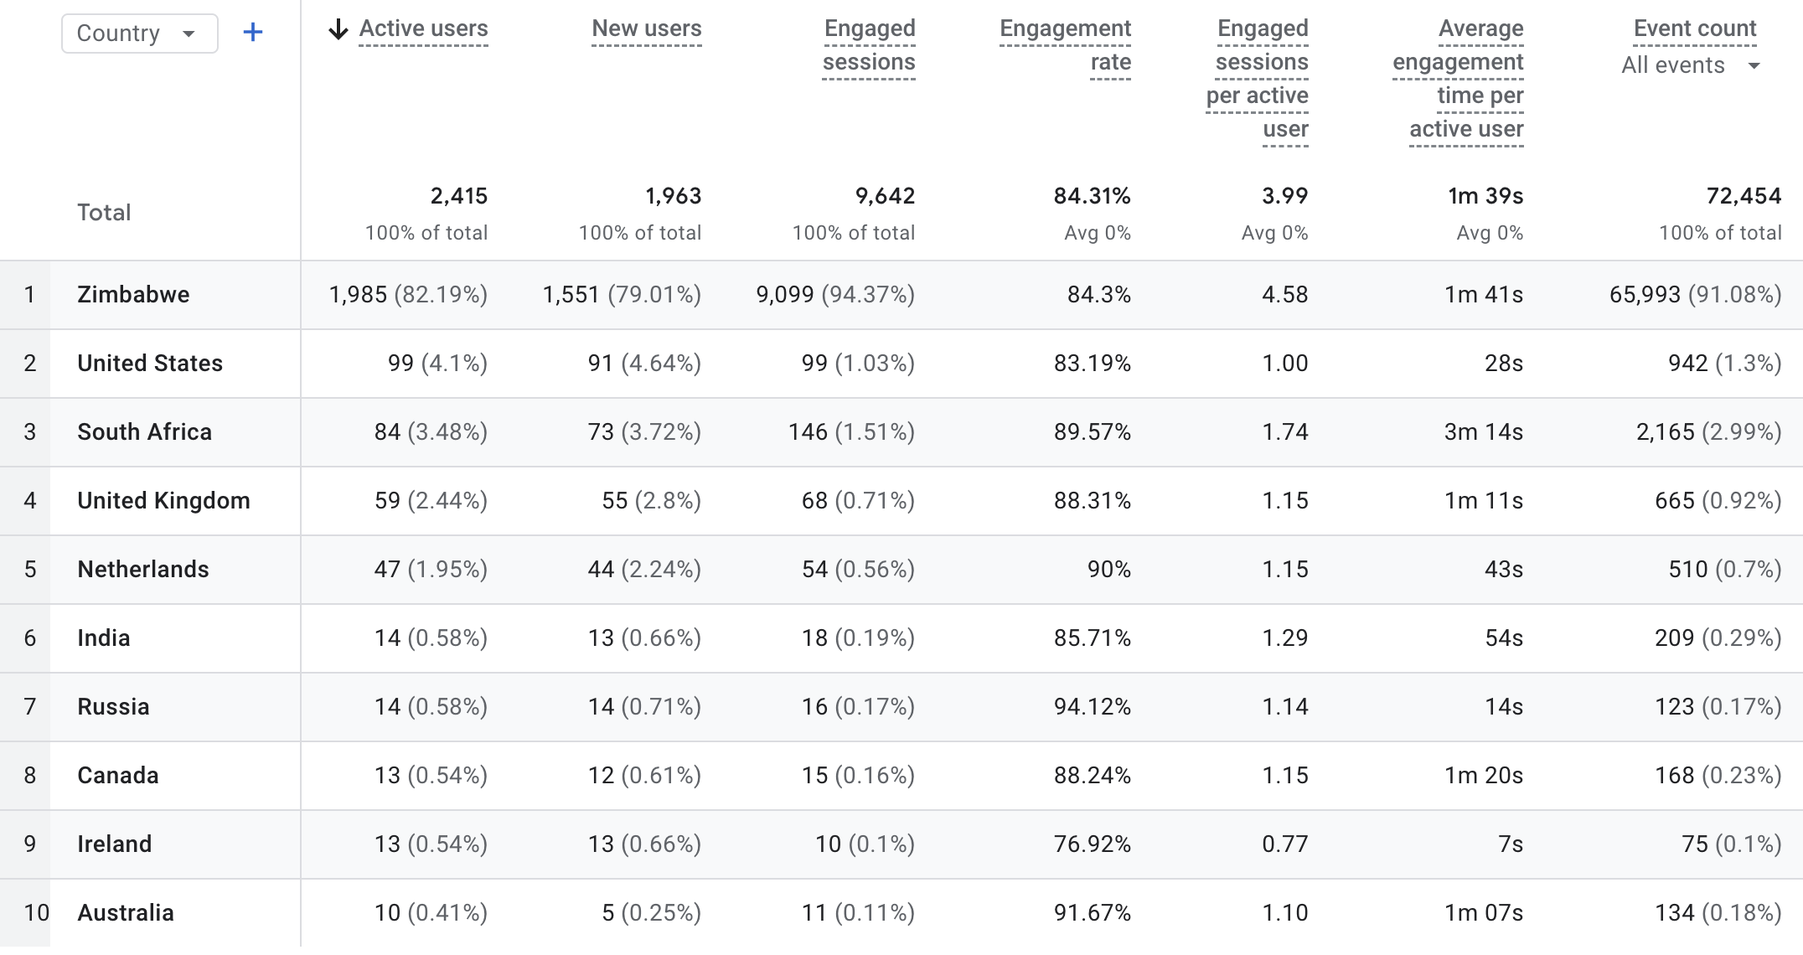
Demographic Overview

Slide 5
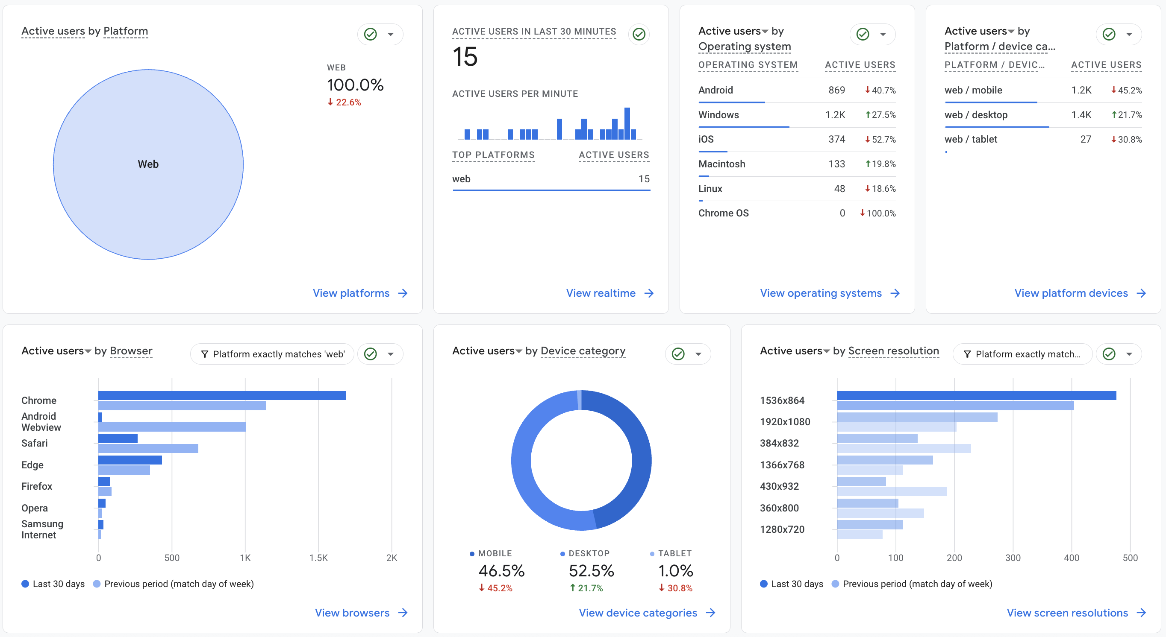
Tech Overview

Slide 6
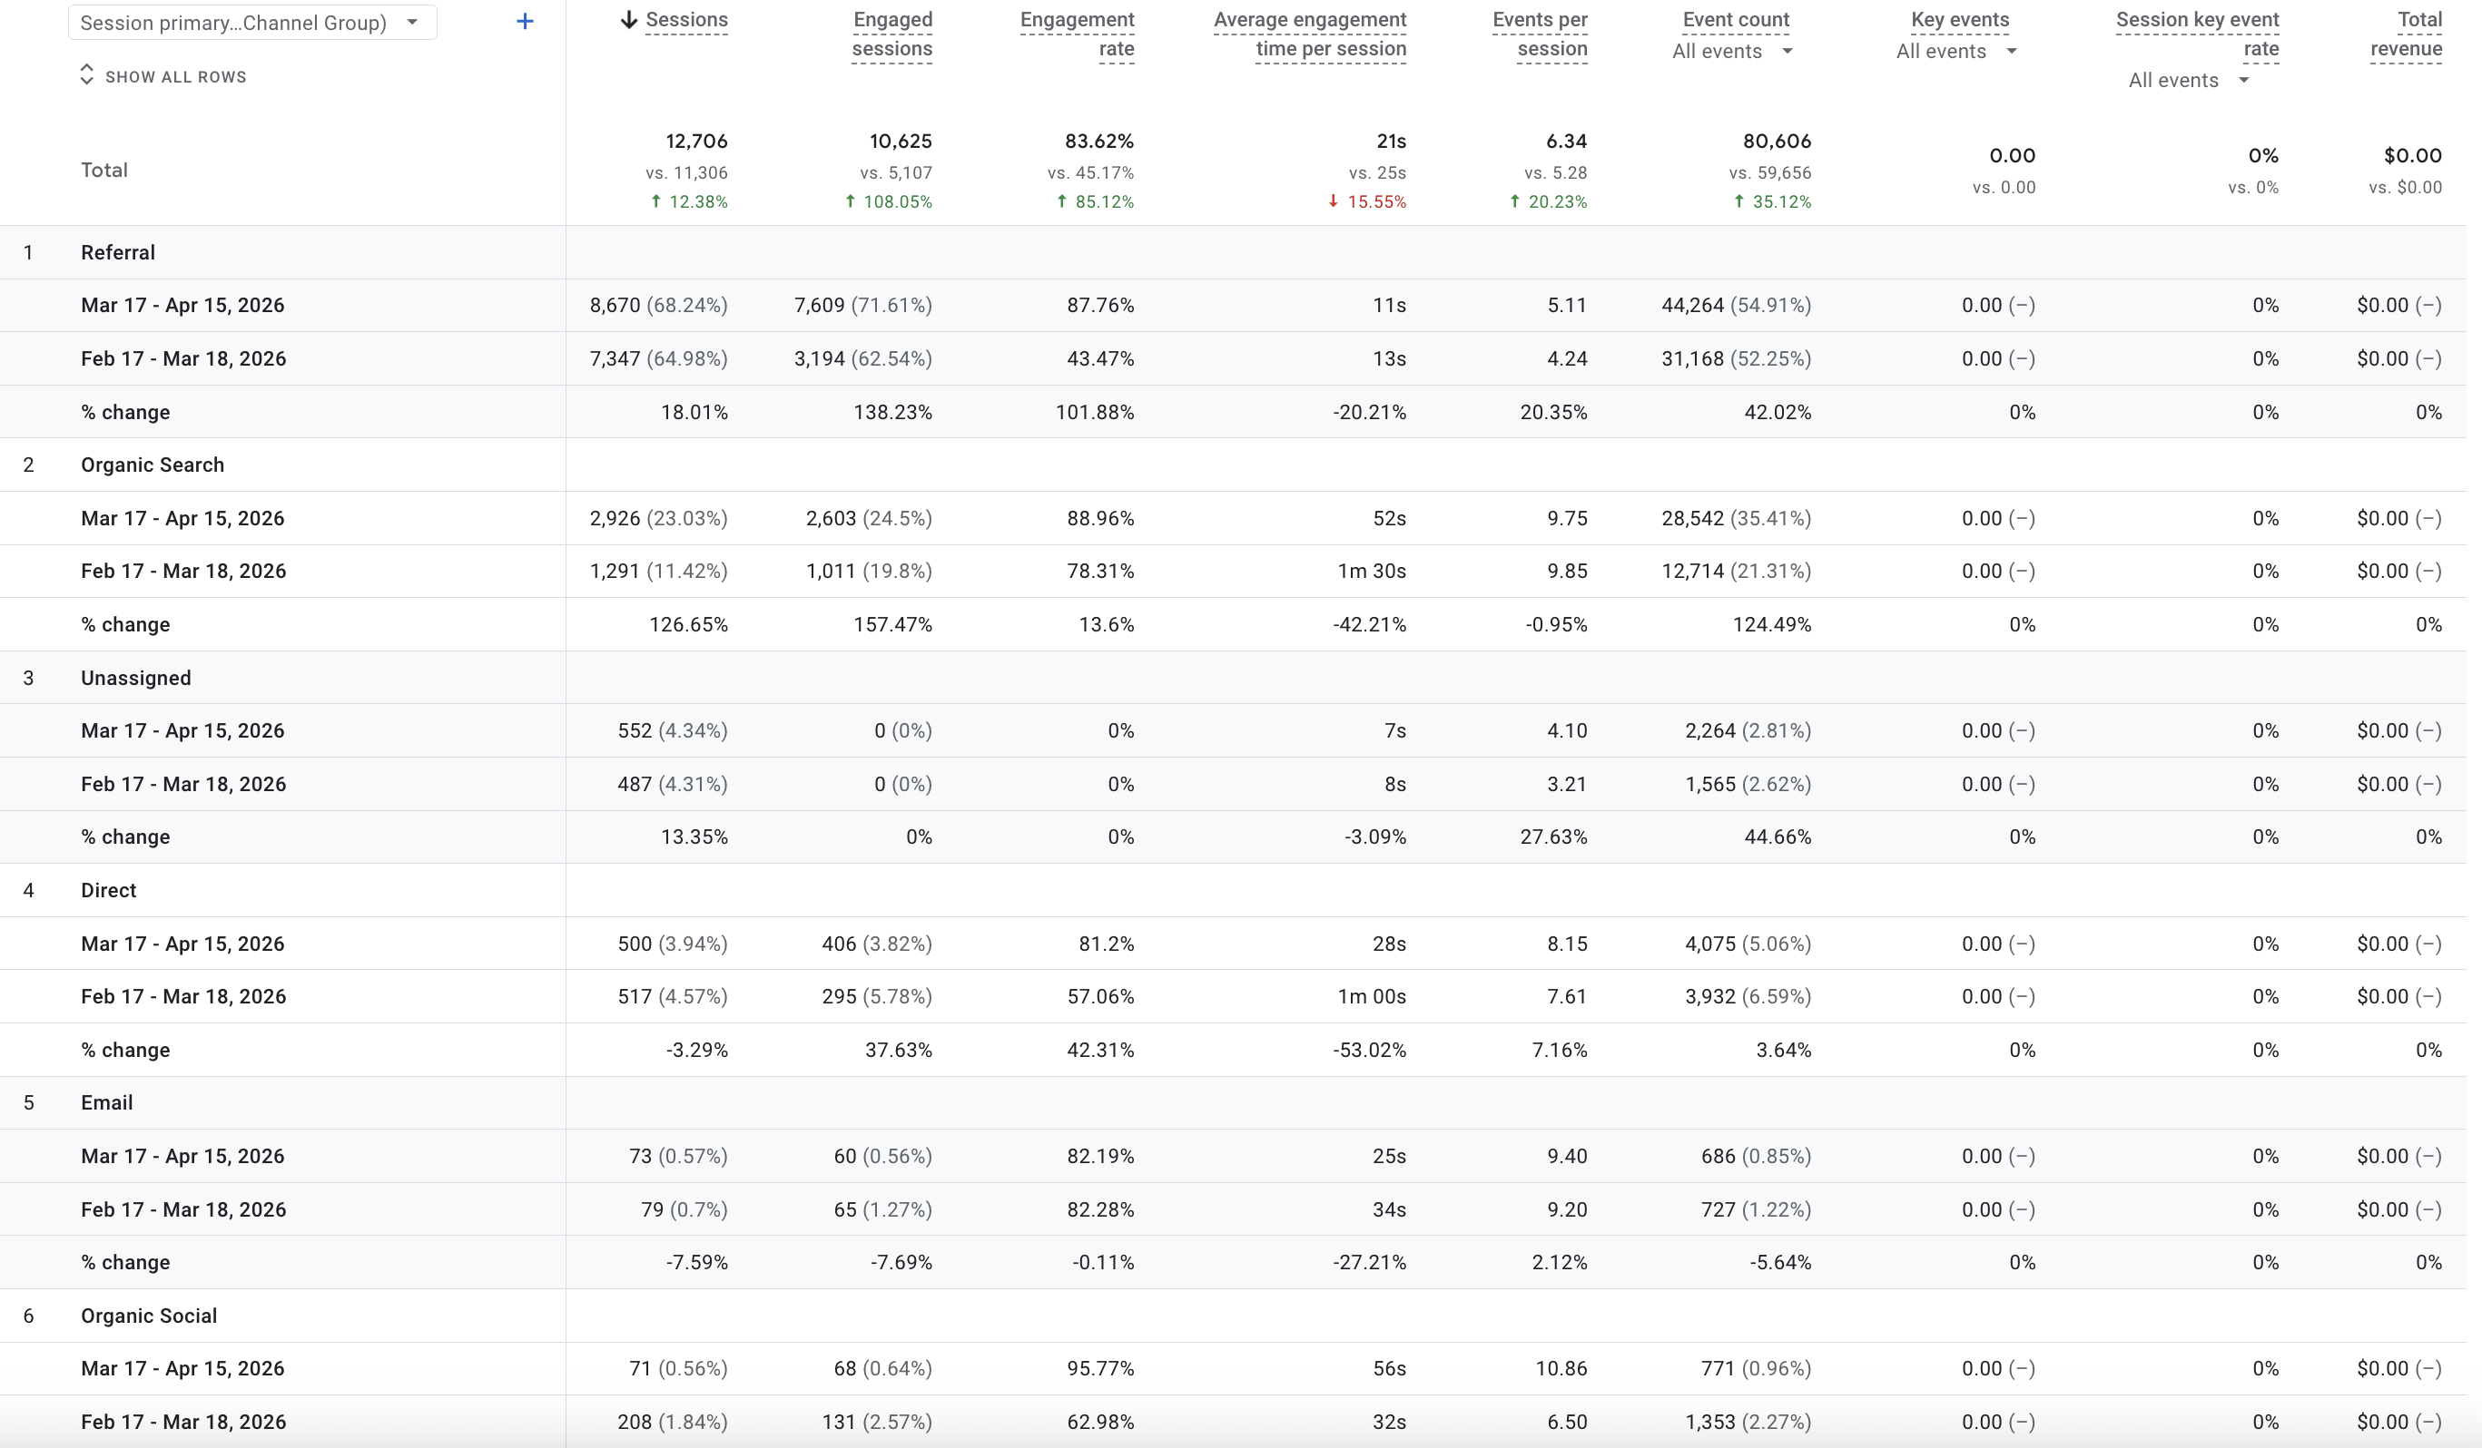
Traffic Sources

Slide 7
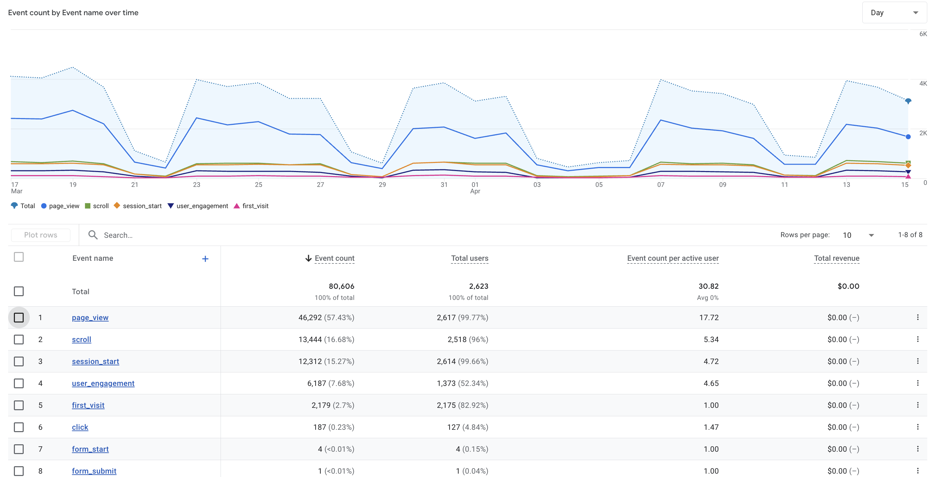
Events Overview
Total activity is 80,606 events from 2,623 users, showing good traffic volume overall.
Page views dominate (57%), meaning most activity is just users browsing pages.
Scroll (16.6%) and session starts (15.3%) show users are visiting and lightly interacting with content.
User engagement is relatively low (7.7%), suggesting limited deep interaction.
Clicks are extremely low (0.23%), indicating users are not taking many actions.
Conversions are almost non-existent — only 4 form starts and 1 form submission recorded.
A large portion of users are new visitors (first_visit ~83%), meaning retention may be low.

Slide 8

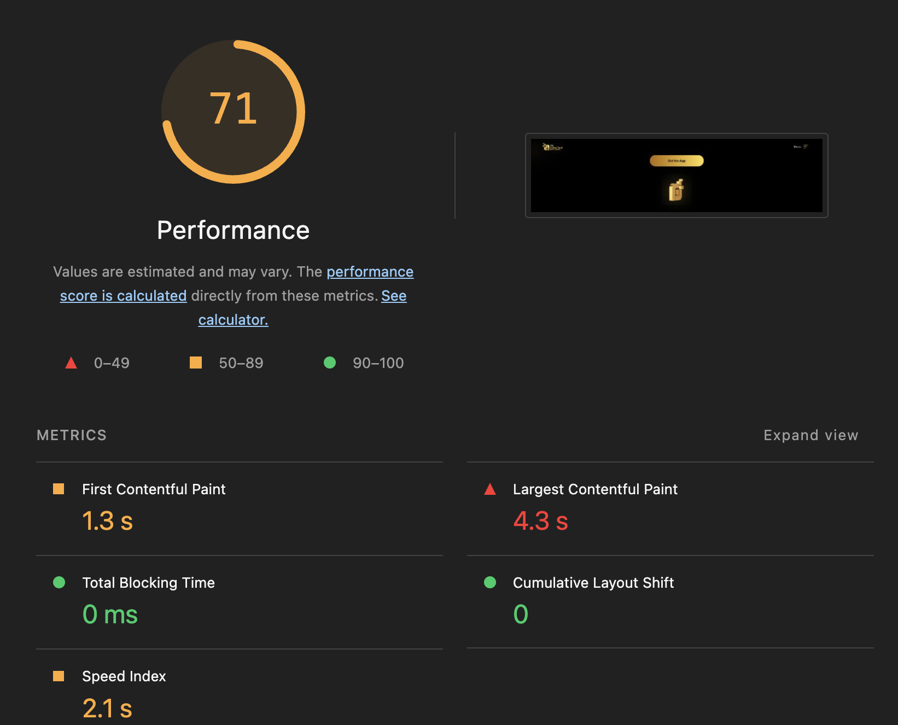
Performance Overview

Slide 9
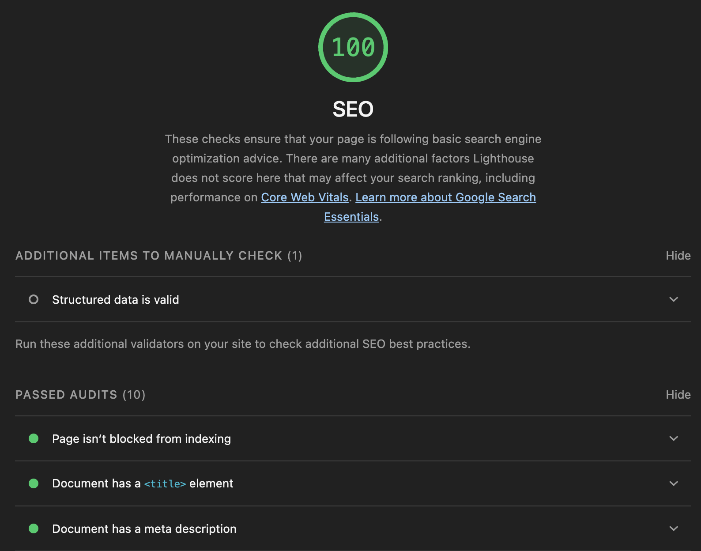
SEO Results

Slide 10
Recommendations
Add strong, visible CTAs (e.g. “Open Account”, “Apply Now”) across all key pages.
Simplify forms to 3–5 fields to reduce drop-offs.
Use sticky buttons on mobile to drive continuous user action.
Add interactive tools (e.g. loan calculators) to boost engagement.
Guide users with clear navigation into key services beyond the homepage.
Link related pages to encourage deeper browsing (internal linking).
Improve mobile speed to reduce bounce rates and increase engagement.
Align ad messaging with landing pages to improve user retention.
Strengthen SEO to drive more qualified, intent-based traffic.
Retarget visitors to improve return visits and conversions.
Add trust signals (testimonials, security badges) to increase confidence.

